Slide 1
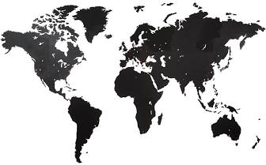
Global Environmental Litigation
Pr. Sandrine Clavel
Dr. Aude-Solveig Epstein
Pr. Patrick Jacob
2020

Slide 2
Chapter 1. A mapping of the available options
Introduction: the decision to litigate
Overview of the available options
Drivers for the selection of an option

Slide 3
Chapter 1. A mapping of the available options
The decision to litigate
Diversity of the available options
The drivers for the selection of an option

Slide 4
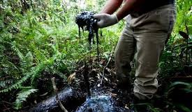
The decision to litigate
The issue: the adverse effects of transnational corporations activities on indigenous communities
Indigenous communities are specially exposed
Transnational corporations activities are difficult to frame legally
Global litigation as a “necessary evil”
The impacts of litigation
Direct impacts
Indirect impacts
The necessity to go global
Diversity of the stakeholders
Diversity of the available options
The need for a toolbox

Slide 5
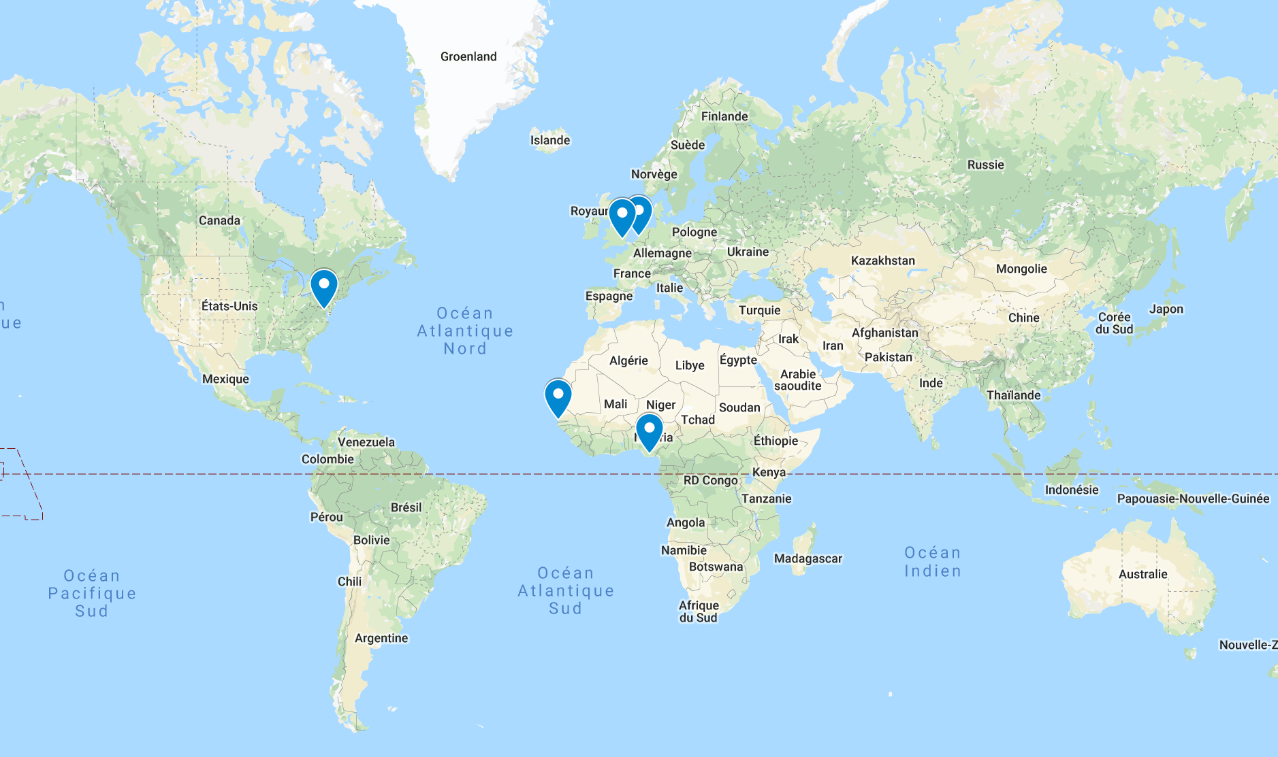
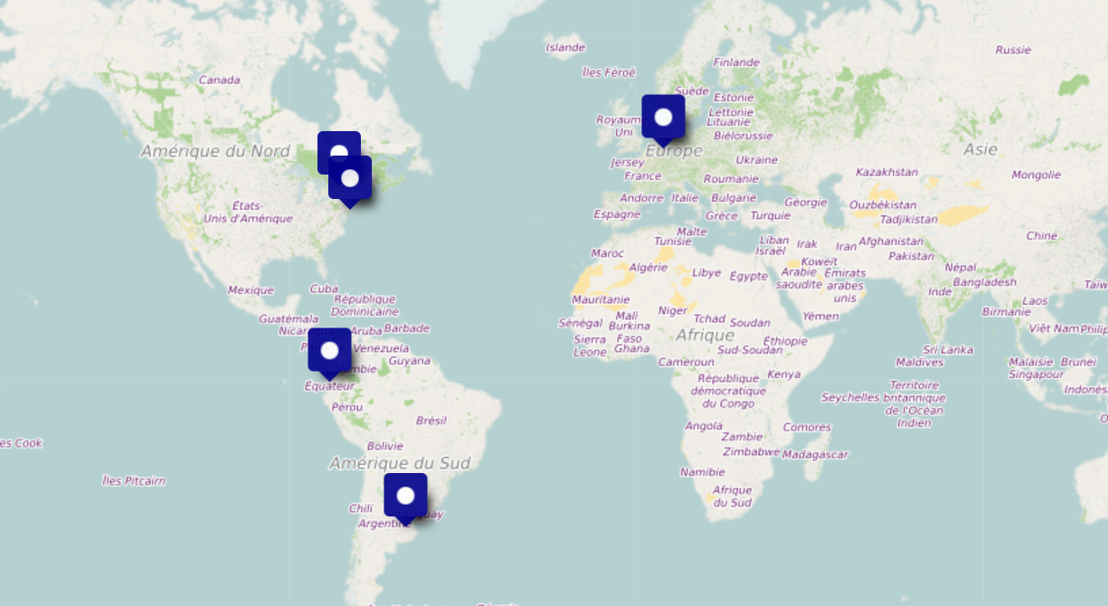
1. Diversity of the available options
Level:
Domestic or international
Potential claimants:
Individuals, peoples, NGOs or States
Potential defendants:
Corporations, States, individuals or NGOs
Potential remedies:
Compensation, restoration, satisfaction, cessation, non-repetition
Potential effects:
Binding and non-binding mechanisms, awareness
Dispute settlement mechanisms seized in the Shell/Ogoni dispute
Dispute settlement mechanisms seized in the Chevron/Ecuador dispute

Slide 6
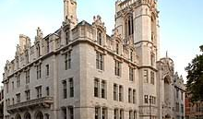
Domestic mechanisms
Domestic courts
Of the State in which the damage occurred
Of another State
Alternative dispute resolutions bodies
Framework:
Claimants: individuals, peoples or NGOs
Defendants: individuals, businesses (direct author or its parent company), public authorities
Issues:
Independence
Jurisdiction
Enforcement

Slide 7
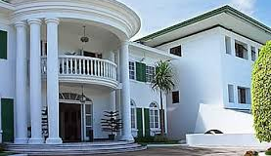
International Courts
The available courts:
The ICJ: interstate disputes
Human-Rights regional courts (ECtHR, IACtHR, ACtHPR) : Individual, groups or NGOs v. States
The ICC: Criminal responsibility of individuals
Issues:
Jurisdiction based on States’ consent
Articulation with domestic remedies
Implementation/enforcement

Slide 8
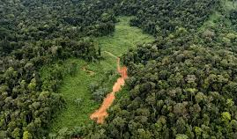
Other international mechanisms
Human-rights treaty bodies (HCR, CERD…)
Individuals, Peoples or NGOs v. States
The “Montagne d’or” case before CERD (2019)
OECD National Contact Points
Individuals, Peoples NGOs v. Businesses
World Bank Inspection Panel
Affected persons v. the World Bank
Issues:
Jurisdiction
Implementation

Slide 9
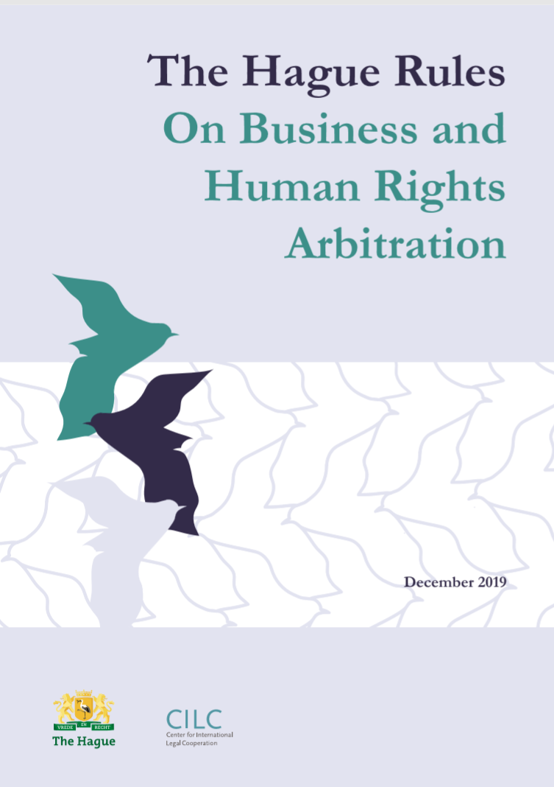
International arbitration
Inter-State arbitration
Arbitration between private persons :
Bangladesh framework agreement on Fire and Building Safety: dispute settlement by the Permanent Court of Arbitration (PCA)
Hague Rules on Business and Human Rights arbitration
Investor-State arbitration (indirect impact on indigenous rights)

Slide 10
2. Drivers for the selection of an option
Availability
Procedural hurdles
Potential outcome

Slide 11
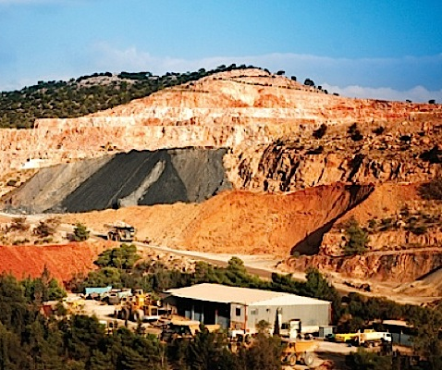
Availability
Standing
Jurisdiction
Admissibility

Slide 12
Procedure
Proof and evidence
Costs
Interim measures
Publicity and participation

Slide 13
Outcome
The defendant
The remedies
Type
Bindingness
Implementation/enforcement
Direct effect and indirect impact

