Slide 1
Global Environmental Litigation
Pr Sandrine Clavel
Dr Aude-Solveig Epstein
Pr Patrick Jacob
2020

Slide 2
Chapter 2. Jurisdiction and Admissibility
Introduction
Jurisdiction
Ratione materiae
Ratione personae
Ratione temporis
Ratione loci
Admissibility
Before International Courts
Before Domestic Courts

Slide 3
Introduction
Origin of the rules governing jurisdiction and admissibility
Regarding international courts and tribunals
Regarding domestic courts
Domestic law conditioned by international law
Role of international law
Restrictive: the issue of extraterritoriality
Expansive: from the UN Guiding Principles on Business and Human Rights (Ruggie principles) towards a binding treaty on Business and Human rights
Ruggie principles, third pillar: “States should take appropriate steps to ensure the effectiveness of domestic judicial mechanisms when addressing business-related human rights abuses, including considering ways to reduce legal, practical and other relevant barriers that could lead to a denial of access to remedy”

Slide 4
1. Jurisdiction a. Ratione personae
The claimant
Quality
Interest
The respondent
Corporation
States
Funders

Slide 5
The claimant
Claim by an individual
HRC, Lubicon Lake case, 1990: might an individual invoke a collective right?
Claim by a NGO, as group representative
ACtHR, Ogiek of the Mau Forest, 2017
Class-action
British Supreme Court, Vedanta, 2019

Slide 6
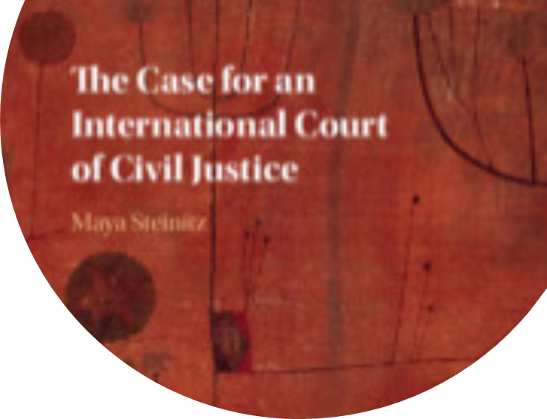
The defendant
Corporations (or NGOs)
States
Funders: The World Bank, the UNDP
WBIP, Kenya: Electricity Expansion Project, case 97, request 14/06, panel investigation report, 2 July 2015

Slide 7
1. Jurisdiction b. Ratione loci
International courts and tribunals
Being under a State party’s jurisdiction
But see the colonial clause issue in the Chagos case before the ECtHR
Domestic courts (Vedanta and Shell/Ogoni)
Private international law approach
Territorial/personal jurisdiction
The parent company
The subsidiary company
Public (human rights) law debates
CESCR, general comment 24
Nait-Liman case before the ECtHR
Draft for a binding instrument to regulate the activities of transnational corporations

Slide 8
Draft of the Legally binding instrument to regulate, in international human rights law, the activities of transnational corporations and other business enterprises
Article 9. Adjudicative Jurisdiction
1. Jurisdiction with respect to claims brought by victims, irrespectively of their nationality or place of domicile, arising from acts or omissions that result or may result in human rights abuses covered under this (Legally Binding Instrument), shall vest in the courts of the State where
a. the human rights abuse occurred;
b. an act or omission contributing to the human rights abuse occurred; or
c. the legal or natural persons alleged to have committed an act or omission causing or contributing to such human rights abuse in the context of business activities, including those of a transnational character, are domiciled.
The above provision does not exclude the exercise of civil jurisdiction on additional grounds provided for by international treaties or national law.
2. Without prejudice to any broader definition of domicile provided for in any international instrument or domestic law, a legal person conducting business activities of a transnational character, including through their business relationships, is considered domiciled at the place where it has its:
a. place of incorporation; or
b. statutory seat; or
c. central administration; or
d. principal place of business; or
3. Where victims choose to bring a claim in a court as per Article 9.1, jurisdiction shall be obligatory and therefore that courts shall not decline it on the basis of forum non conveniens.
4. Courts shall have jurisdiction over claims against legal or natural persons not domiciled in the territory of the forum State, if the claim is closely connected with a claim against a legal or natural person domiciled in the territory of the forum State. 5. Courts shall have jurisdiction over claims against legal or natural persons not domiciled in the territory of the forum State if no other effective forum guaranteeing a fair trial is available and there is a sufficiently close connection to the State Party concerned.

Slide 9
2. Admissibility
International courts
Exhaustion of domestic remedies
Time-limitation
Claim already submitted to another body
Domestic courts
Immunities, act of State
Ne bis in idem
Forum non conveniens

Slide 10
Forum non conveniens
The doctrine
US Court of appeals for the 2nd circuit, Aguinda v. Texaco, 2002
The Ecuadorian courts decision
…
Decline
See Draft binding treaty : art. 7, al. 5: State Parties shall ensure that the doctrine of forum non conveniens is not used by their courts to dismiss legitimate judicial proceedings brought by victims.

Slide 11
Connexity/Ne bis in idem
ECHR, Article 35, al 2.: “The Court shall not deal with any application submitted under Article 34 that (…) (b) is substantially the same as a matter that has already been examined by the Court or has already been submitted to another procedure of international investigation or settlement and contains no relevant new information”.
OP ICPR, article 5, al. 2 : 2. « The Committee shall not consider any communication from an individual unless it has ascertained that: (a) The same matter is not being examined under another procedure of international investigation or settlement”;
France’s reservation: “France makes a reservation to article 5, paragraph 2(a), specifying that the Human Rights Committee shall not have competence to consider a communication from an individual if the same matter is being examined or has already been considered under another procedure of international investigation or settlement”.

