Slide 1
Global Environmental Litigation
Pr. Sandrine Clavel
Dr. Aude-Solveig Epstein
Pr. Patrick Jacob
2020

Slide 2
Chapter 3. Procedural issues
Interim measures
Evidence
Publicity and participation
Costs

Slide 3
Interim measures
International mechanisms
Admissibility of interim measures
Binding character of interim measures:
ECtHR, Mammatkulov v. Turkey, 2005
Domestic mechanisms
Forum shopping (jurisdiction of courts, power of judges)
Territorial scope / coordination

Slide 4
Evidence
Rules regarding evidence
Forms of proof
Burden of proof
Standard of proof
Powers of the tribunal
Discovery
Investigation powers
Subject of proof (impossible proof, presumptions)

Slide 5
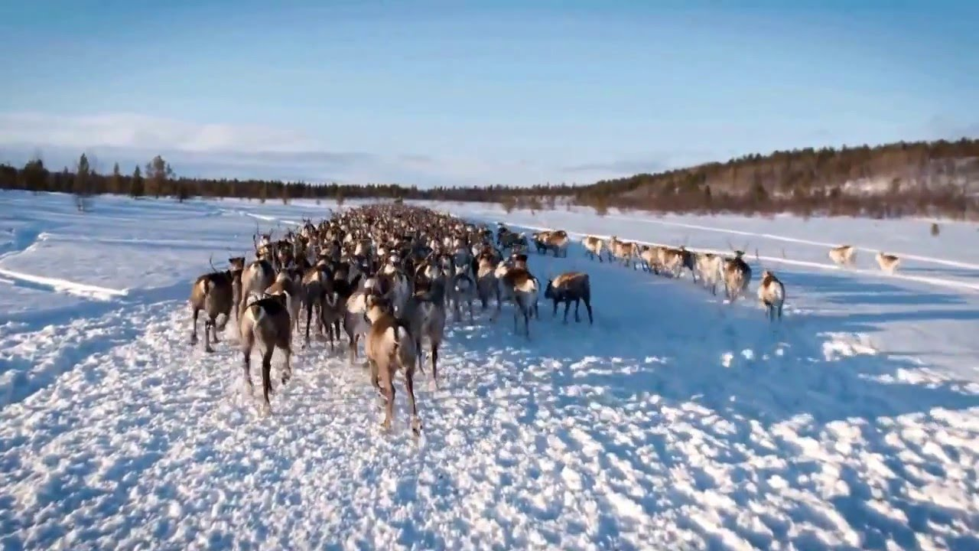
Evidence
Domestic rules with limited international scrutiny (right to a fair trial)
ECtHR, Handolsdalen Sami village v. Sweden, decision, 17th February 2009

Slide 6
Publicity and participation
Courts and tribunals:
Principle of publicity
Arbitration and ADR
Principle of confidentiality (?)
Getting public? (Investment arbitration – NCP: Survival v. WWF)
Contribution of stakeholders? Intervention, amicus curiae

Slide 7
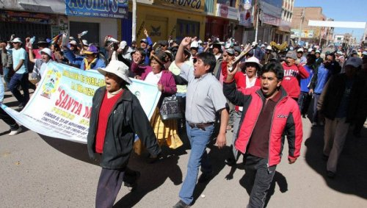
Amicus curiae
ICSID, Bear Creek Mining v. Peru, ARB/14/21, amicus curiae application by the Association of Human Rights and the Environment
ICSID: Chevron v. Ecuador (case-study)

Slide 8
Costs
What are costs?
Costs of the proceedings
Costs of legal representation
Who should bear the costs?
The « collectivity » (legal aid)
The parties
The defeated party: costs follow the event

Slide 9
Costs
Domestic rules with limited international scrutiny (right to a fair trial)
ECtHR, Handolsdalen Sami village v. Sweden, judgment, 30 March 2010, at 51-59

