Slide 1
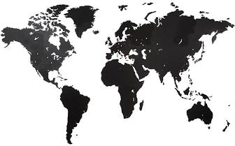
Global Environmental Litigation
Pr. Sandrine Clavel
Dr. Aude-Solveig Epstein
Pr. Patrick Jacob
2020

Slide 2
Chapter 4. Outcome of the proceedings – Settlements and decisions
Possible outcomes
Sovereign immunities
Scope of the decision
Enforcement procedures

Slide 3
Possible outcomes
Supranational
(international and regional) courts
Judgments
Opinions
Domestic courts
Criminal judgments
Administrative judgments
Civil and commercial judgments
Transnational courts
(arbitral tribunals)
Investment arbitration awards
Commercial arbitration awards
Domestic Arbitration
Arbitration awards
Others supranational bodies
ADR
Settlements
Settlements
Recommendations
Reports/ Statements

Slide 4
Criteria to be considered in the assessment of the outcomes
Immunity from execution
Remedies and sanctions
Personal scope
Territorial scope
Review procedures

Slide 5
Available remedies and sanctions
Compensation
Restorative measures
Punitive sanctions
Reputational sanctions

Slide 6
Territorial scope: transnational enforcement?
International courts’ judgments
Settlements
Domestic courts’ judgments
Strict territorial execution
Local enforcement
Extraterritorial enforcement through territorial execution
Worldwide scope?
Enforcement abroad
Exécution abroad

Slide 7
Sovereign immunities
Immunity from jurisdiction
Immunity from execution
United Nations Convention on Jurisdictional Immunities of States and Their Property, New York, 2 December 2004
Article 20 - Effect of consent to jurisdiction to measures of constraint Where consent to the measures of constraint is required under articles 18 and 19, consent to the exercise of jurisdiction under article 7 shall not imply consent to the taking of measures of constraint.
Constraint subjected to:
-Express consent of the State (and qualified?); or
-Specific allocation of the goods; or
-The nature of property induces its commercial purpose

Slide 8
Enforcement procedures
Monitoring procedures/ follow up
Infringement procedures
Domestic enforcement mechanisms
Comparative law

