Slide 1
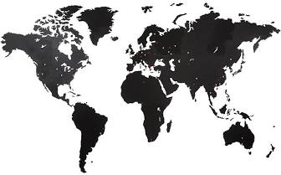
Global Environmental Litigation
Pr. Sandrine Clavel
Dr. Aude-Solveig Epstein
Pr. Patrick Jacob

Slide 2
The Kichwa de Sarayaku v. Ecuador dispute A case-study
UVSQ
2020

Slide 3
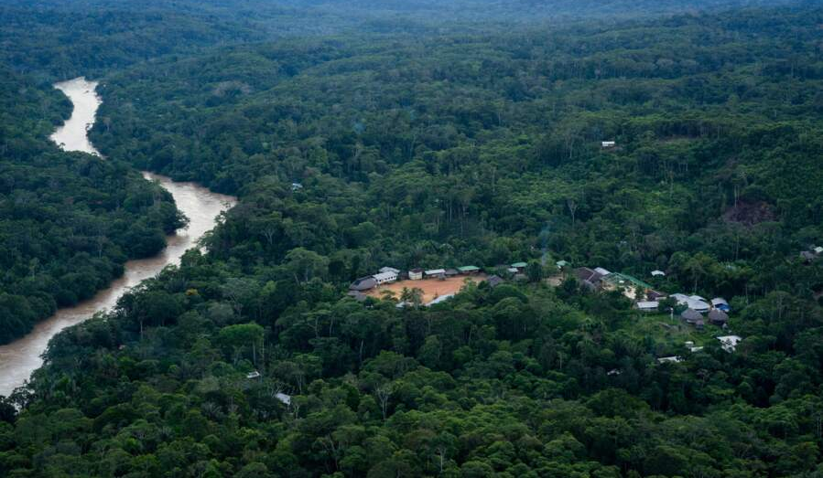
A (very) brief summary of the facts
A small and isolated community
1996: signature of an oil exploration contract between Petroecuador and CGC
1996-…: social protest from the Kichwa de Sarayaku people
2002-2003: seismic survey, using 1.4 tons of explosives loaded in the Sarayaku territory
2003: termination of the seismic survey due to protest
2010: termination of the contract
The explosives remain buried in Sarayaku territory

Slide 4
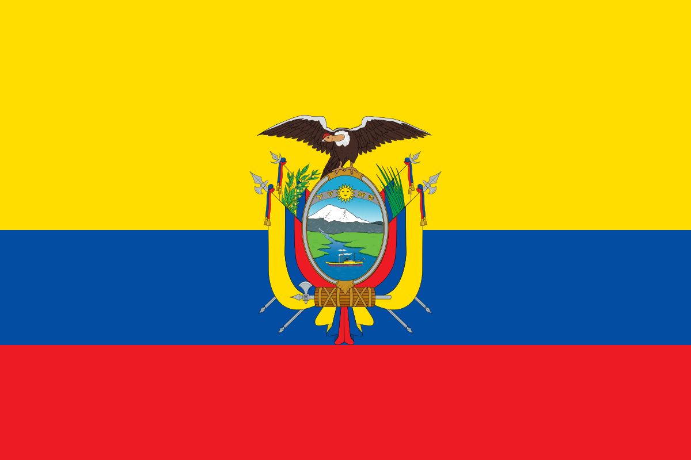
Actors
Ecuador
The Kichwa de Sarayaku people
Compana general de combustibles (Arg.)
NGOs

Slide 5
Domestic mechanisms and their limits
Ecuadorian legal framework
Ombudsman
Domestic courts

Slide 6
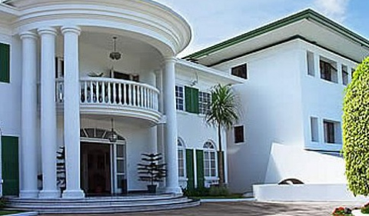
The Inter-american Court of Human Rights
Procedure
Merits
Reliefs
Follow-up

Slide 7
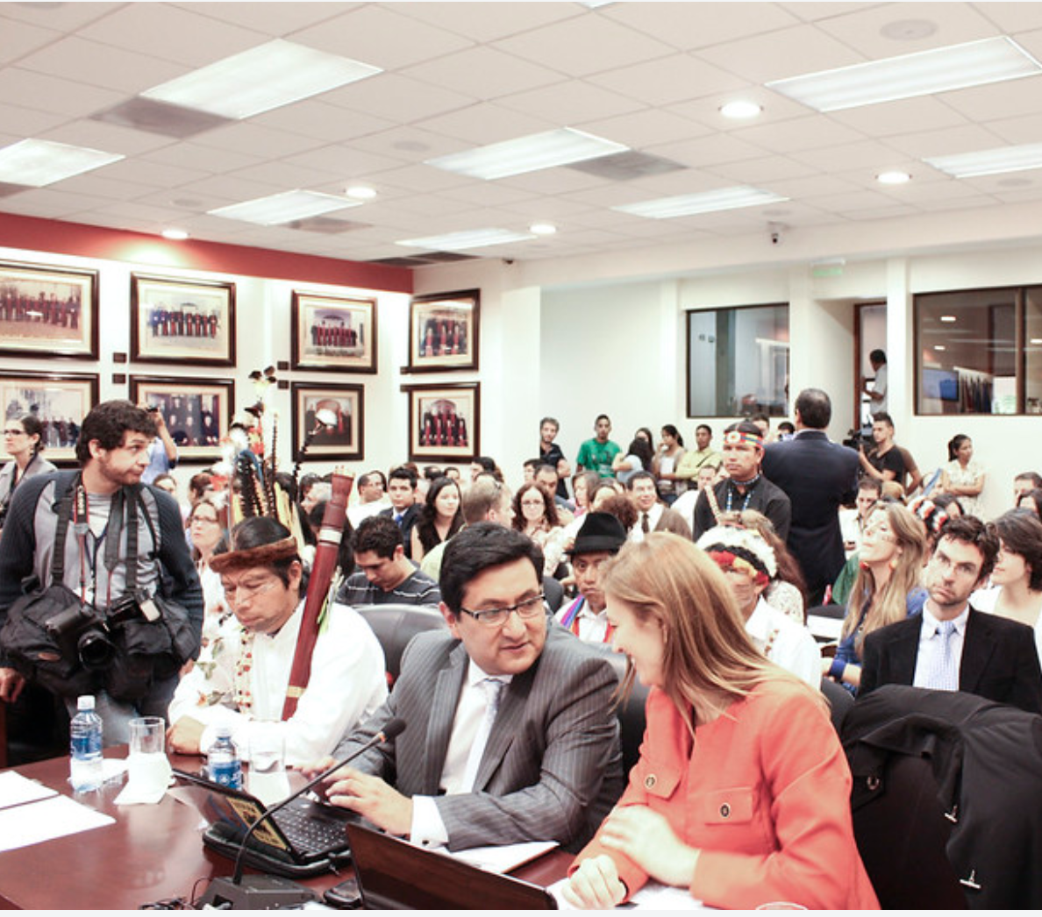
Procedure
The claimants:
The initial petitioners
The role of the Inter-American commission
The participation of the initial petitioners and the victims in the proceeding
The defendant:
State’s responsibility for its failure to ensure the respect of IP rights by private companies
Admissibility:
Exhaustion of domestic remedies
Procedural aspects
Field visit
Proof
Provisional measures

Slide 8
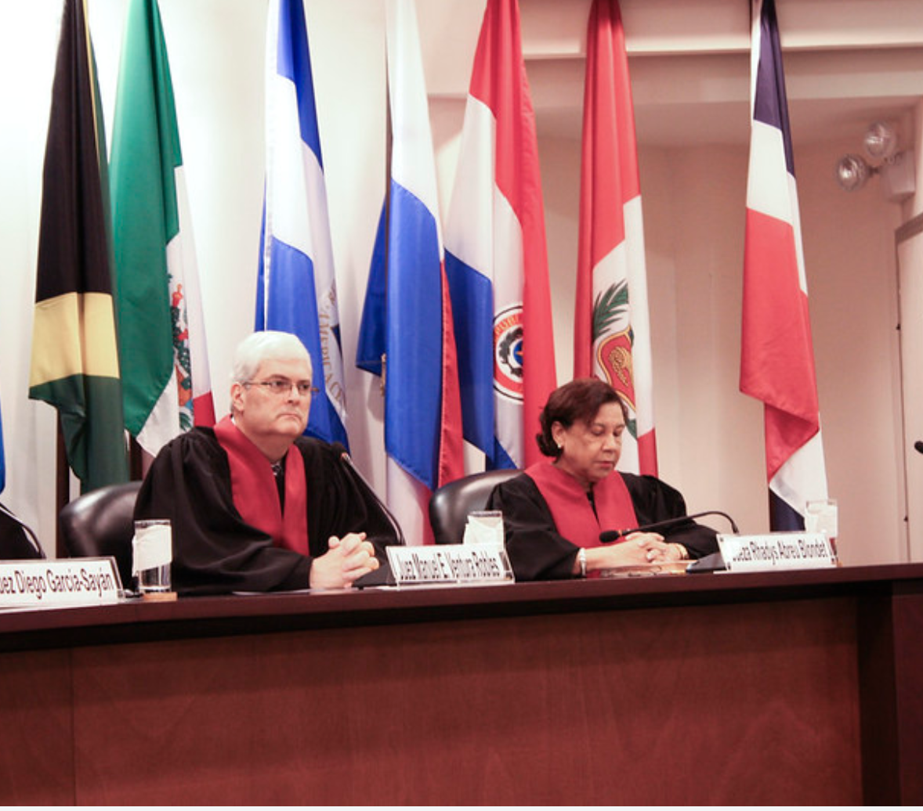
Merits
Right to prior and informed consultation, in relation with the rights to property and to cultural identity
PIC as a general principle of international law
Content of the right to PIC
PI consultation v. PI consent
Due diligence obligations that cannot be delegated

Slide 9
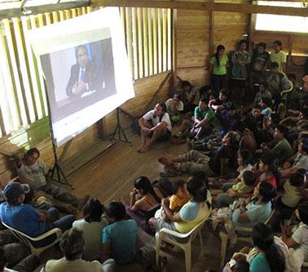
Reliefs
Principle of full reparation
Diversity of the means to ensure full reparation
Restitution: obligation to neutralize explosives
Satisfaction: public acknowledgment of responsibility
Compensation: financial penalty
Guarantees of non-repetition: changes in the law and legal training

Slide 10
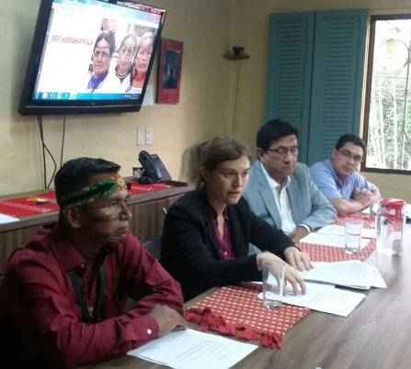
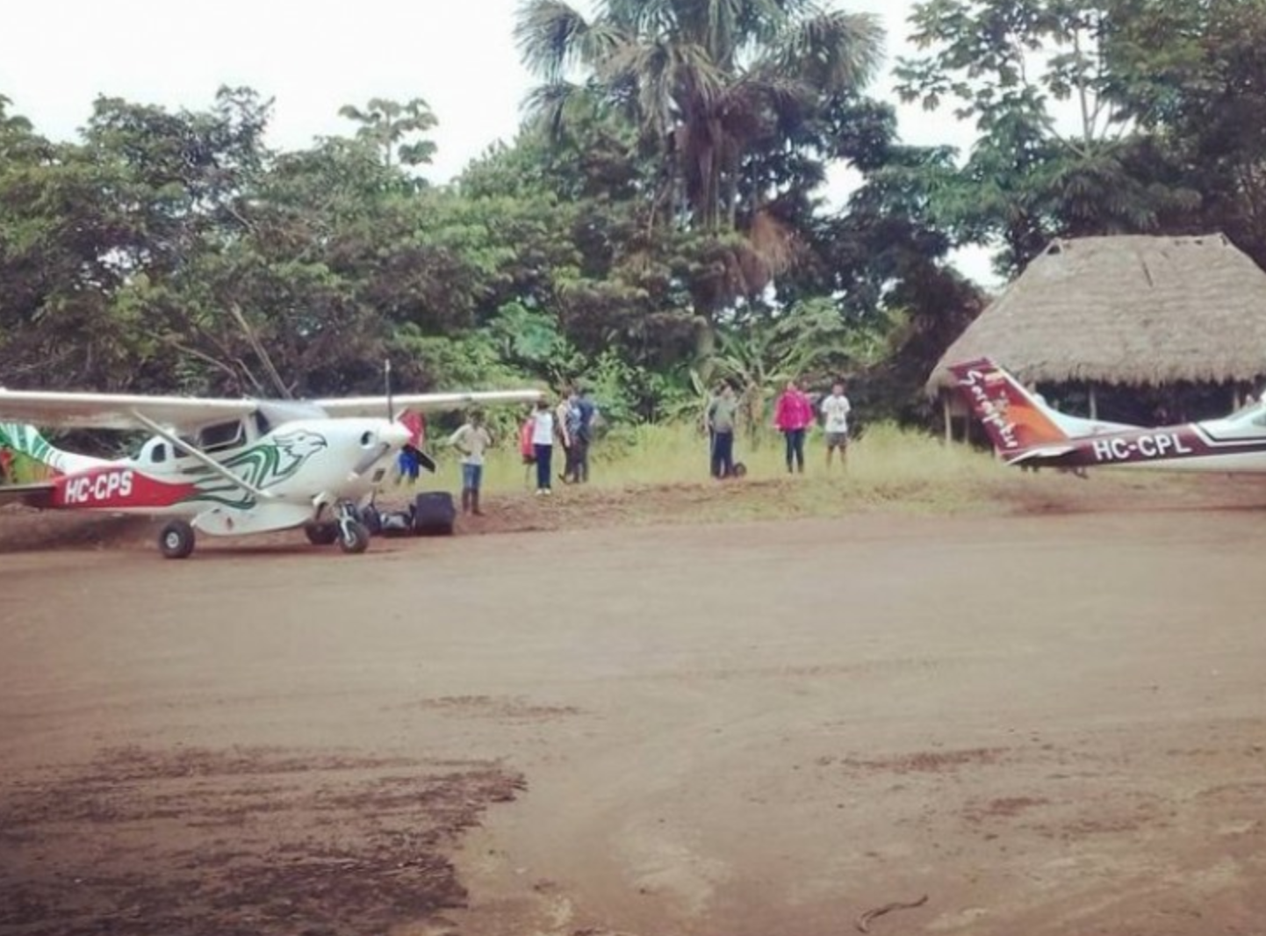
Follow-up
Monitoring compliance procedure in the hand of the IACtHR itself
Partial compliance
Implementation of the symbolic and financial measures
Partial implementation of the training program
Failure to guarantee the right to PIC to the benefit of all the communities

