Slide 1
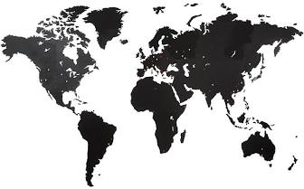
Global Environmental Litigation
Pr. Sandrine Clavel
Dr. Aude-Solveig Epstein
Pr. Patrick Jacob

Slide 2
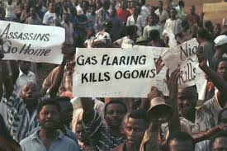
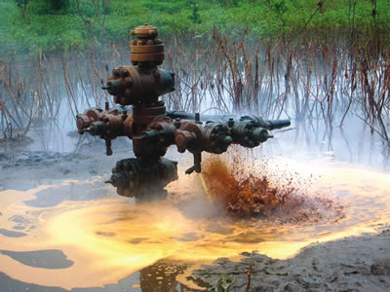
The Shell/Ogoni dispute A case-study
UVSQ
2020

Slide 3
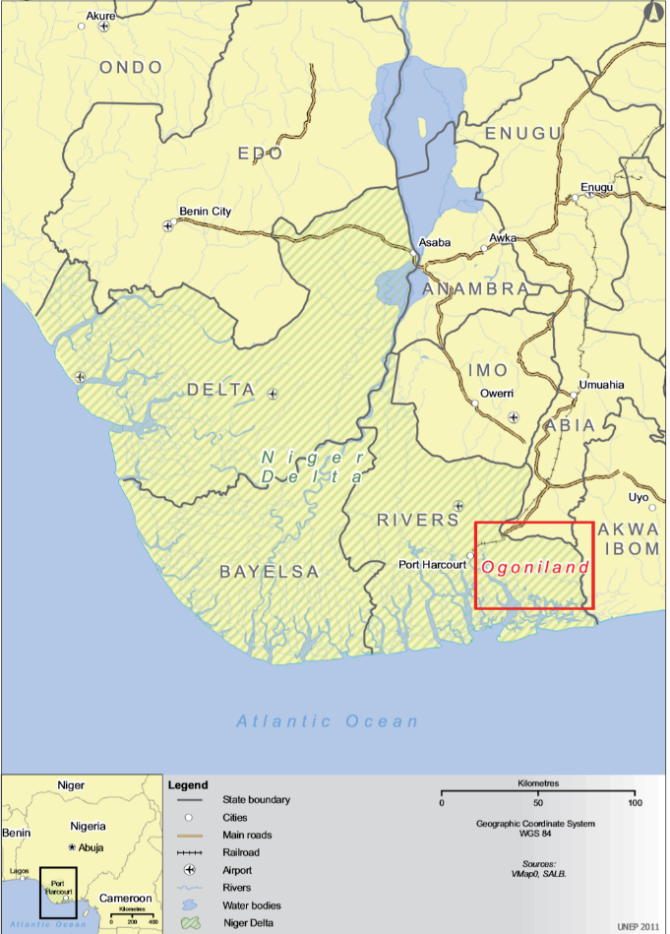
A (very) brief summary of the facts
1950s’: starting of oil production in Ogoniland
1990s’: social protest, especially related to pollutions related to oil production
1993: ending of oil production in Ogoniland
1995: hanging of the « Ogoni nine »
1993-…: ongoing oil pollutions
In Ogoniland
Regular oil spills related to leaks on pipelines
Flares coming from oil wells
In other parts of the Niger delta:
Continuing oil leaks, especially in 2011 (see Jalla case)

Slide 4
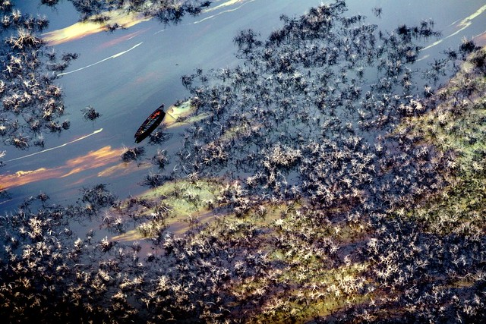
UNEP report, 2011
“Oil contamination in Ogoniland is widespread and severely impacting many components of the environment [contamination of soil and groundwater, impact on health, vegetation and aquatic life]. Even though the oil industry is no longer active in Ogoniland, oil spills continue to occur with alarming regularity. The Ogoni people live with this pollution every day (…) The environmental restoration of Ogoniland is possible but may take 25 to 30 years”

Slide 5
Actors
Nigeria
Ogoni people (and MOSOP)
The Shell group
NGOs

Slide 6
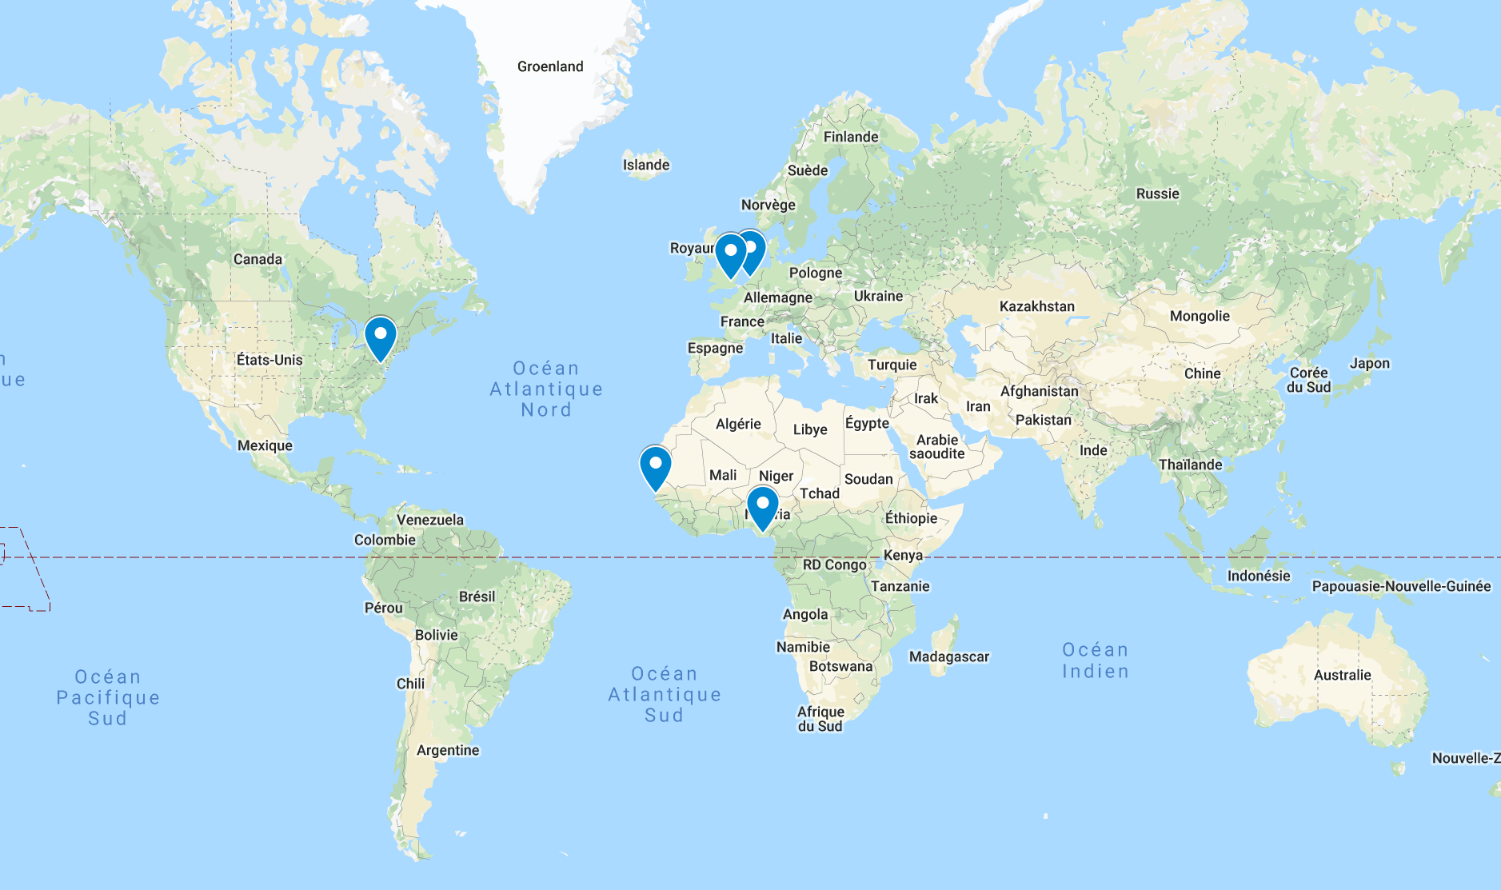
Mapping litigation
Domestic proceedings
Nigeria
Netherlands
United Kingdom
United States
International proceedings
African Commission on Human and People Rights
OECD, Dutch national contact point

Slide 7
Domestic mechanisms
Nigeria
Netherlands
United Kingdom
United States

Slide 8
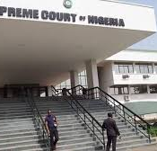
Nigerian cases
Several cases.
See f.i.: The Ejama-Ebubu community case judgment, issued in 2010, and upheld in 2020 by the Nigeria Suprem Court (see ThisDayLive): Shell sentenced to pay $516 million in compensation for the damages caused by an oil spill in 1970
Issues to be discussed:
Procedural issues (length of the proceeding, right to a fair trial)
Enforcement of the decisions.
See: UK, High Court, Chief Osaro Agbara and others vs. SPDC and others, 5 december 2019, denying the enforcement of the judgment in the UK due to procedural failure (Shell having been denied the right to present its case).

Slide 9
Dutch cases
Milieudefensie case:
Hague District Court, Akpan v. Royal Dutch Shell Plc et al., C/09/337050 / HA ZA 09-1580, judgment, 30 January 2013
Court of Appeal of The Hague, Eric Barizaa Dooh of Goi and others v. Royal Dutch Shell Plc and Others, 200.126.843 (case c) + 200.126.848 (case d), 18th December 2015
Case ongoing → judgment by the Court of Appeal on the merits due to be issued in January 2021
Issues to be discussed:
Jurisdiction of Dutch courts, towards the parent company and its subsidiary
Applicable law: Nigerian law
Merits: a civil liability claim; liability of the parent and subsidiary for damages due either to negligence in the maintenance of the pipeline or sabotage (see District Court ruling)
See also: Kiobel case follow-up: Hague district court, 1st may 2019

Slide 10
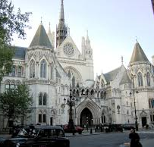
British cases
Bodo case:
Queen's Bench Division (Technology & Construction Court), Bodo Community v Shell Petroleum Development Co of Nigeria Ltd, judgment (preliminary issues), 20 June 2014, [2014] EWHC 1973 (TCC) → Transaction
Okpabi case:
Queen's Bench Division (Technology & Construction Court), Okpabi v Royal Dutch Shell Plc, judgment, 26 January 2017, [2017] EWHC 89 (TCC)
Court of Appeal (Civil Division), Okpabi v Royal Dutch Shell Plc, 14 February 2018, [2018] EWCA Civ 191
Proceeding « chilled » waiting for the Vedanta decision by the Supreme Court; and resumed before the Supreme Court in June 2020
See also Jalla case, also not related to Ogoniland
Jalla & Ors v Royal Dutch Shell Plc & Ors [2020] EWHC 459 (TCC) → jurisdiction affirmed

Slide 11
British cases
Issues to be discussed:
Jurisdiction of British courts
Towards the parent company: Brussel 1 regulation
Towards the Nigerian subsidiary: British law regarding jurisdiction → link with an « anchor » defendant.
Merits
Duty of care of the parent company: an arguable case? (No, according to the first Okpabi judgments since the parent did not exercise operational control over its subsidiary; debattable according to the Jalla judgement in the wake of Vedanta)

Slide 12
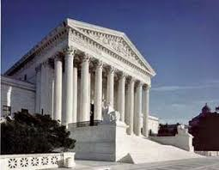
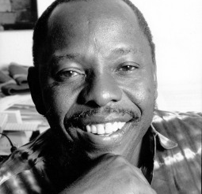
US cases
Cases:
Wiwa case: :United States District Court Southern District of New York, Wiwa v. Royal Dutch Petroleum Co → Settlement on the 8 of June 2009 for 15,5 million USD
Kiobel case : Supreme Court of the United States, Kiobel v. Royal Dutch Petroleum Co., 17 April 2013, 569 U.S. 108 (2013) → Dismissed for lack of jurisdiction
Issues to be discussed:
Object: Liability for extrajudicial killings, torture, property destruction
Defendant: The company, not the Nigerian State, due to State’s immunities
Jursidiction of US Courts: Alien tort statute; But presomption against extraterritoriality in foreign cube cases

Slide 13
International mechanisms
African commission of human rights
OECD, Dutch national contact point

Slide 14
African Commission of Human Rights
African Commission on Human and Peoples’ Rights, Social and Economic Rights Action Center (SERAC) and Center for Economic and Social Rights (CESR) v. Nigeria, 155/96, 27th October 2001
African Charter on Human and Peoples’ Rights, 1981
Right to life, right to health, right to a satifactory environment, right to free disposal of wealth and natural ressources
The African Commission appeals to Nigeria to ensure protection of the environment, health and livelihood of the people of Ogoniland by:
Stopping all attacks on Ogoni communities and leaders (…)
Conducting an investigation into the human rights violations described above and prosecuting officials of the security forces, NNPC and relevant agencies involved in human rights violations;
Ensuring adequate compensation to victims of the human rights violations, including relief and resettlement assistance to victims of government sponsored raids, and undertaking a comprehensive cleanup of lands and rivers damaged by oil operations;
Ensuring that appropriate environmental and social impact assessments are prepared for any future oil development and that the safe operation of any further oil development is guaranteed through effective and independent oversight bodies for the petroleum industry; and
Providing information on health and environmental risks and meaningful access to regulatory and decision-making bodies to communities likely to be affected by oil operations.

Slide 15
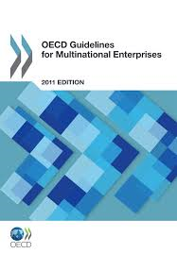
Dutch National contact point
Dutch National Contact point, Amnesty International and Friends of the Earth v. Shell, final statement, 21st September 2014
Wihtdrawn
The OECD Guidelines for multinational enterprises
The National contact point mechanism

