Slide 1
Global Environmental Litigation
Pr. Sandrine Clavel
Dr. Aude-Solveig Epstein
Pr. Patrick Jacob
2020

Slide 2
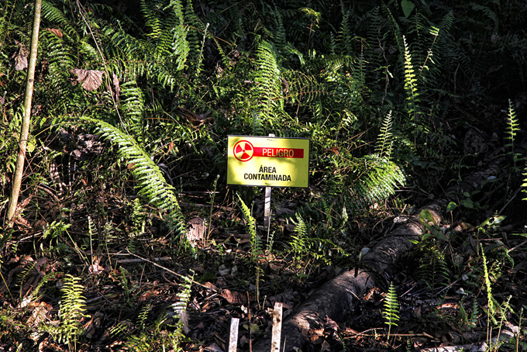
Chevron v. Ecuador A case-study

Slide 3
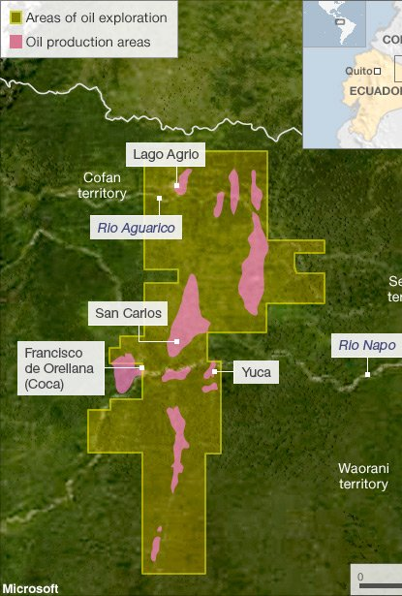
A (very) brief summary of the facts
1960s’: Texaco Petroleum, Texaco’s (USA) Ecuadorian daughter Cie, enters consortium for oil exploitation in Ecuadorian Amazonia.
1990s’: TexPet leaves Ecuador, letting deeply polluted sites. Settlement signed in 1995.
2001: Texaco and TexPet absorbed by Chevron (USA)
Today: The Amazonian sites are still under severe pollution. Biodiversity has been deeply damages, whereas local population have suffered major health issues.

Slide 4
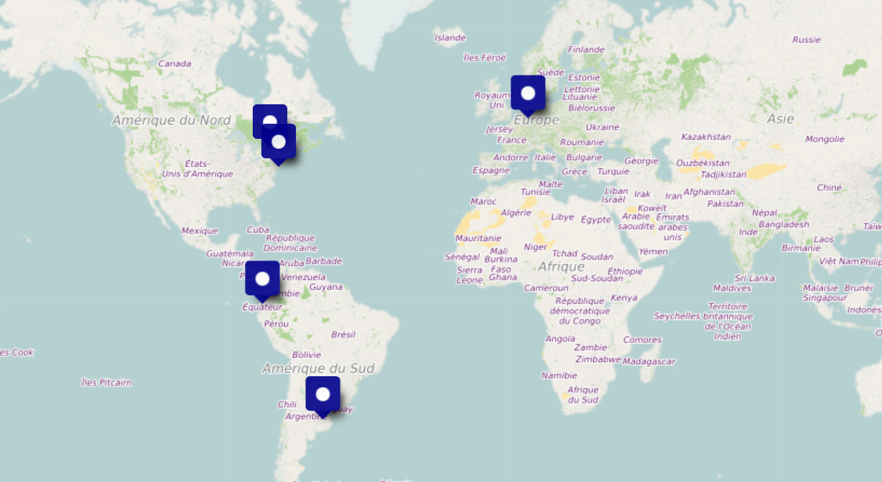
Mapping litigation
Domestic proceedings
Ecuador
USA
Canada
Argentina…
International Investment Arbitration
Permanent Court of Arbitration, The Hague, Netherlands
International Criminal Court, The Hague, Netherlands

Slide 5
Claims brought by the Lago Agrio People

Slide 6
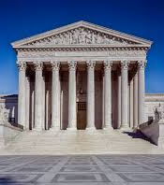
Suing Texaco in the USA
U.S. District Court for the Southern District of New York - 142 F. Supp. 2d 534 (S.D.N.Y. 2001), Aguinda v. Texaco, Inc., 142 F. Supp. 2d 534 (S.D.N.Y. 2001), May 30, 2001
Appeal Court of NY, 2e Circuit, 16 Oct. 2002: Aguinda v. Texaco. Inc., 303 F.3d 470 (2d Cir. 2002) ; Jota v. Texaco. Inc., 157 F.3d 153, 2d Cir. 1998 (decision)
Issues to be discussed:
Jurisdiction of US Courts
Forum non conveniens
Submission to Ecuadorian Courts

Slide 7
Suing Chevron in Ecuador
Ecuadorian Superior Court of Nueva Loja (Provincial court of Justice of Secumbios), 14 Feb. 2011: Damages to be paid up to 17 billion dollars, of which more than 8 billion as punitive damages (decision in English)
Appeal Court Ecuador, 3 Jan. 2012: Judgment of the tribunal upheld
National Court of Justice, 12 Nov. 2013 : Judgment upheld, although the final amount to be paid is reduced to 9,5 billion dollars
Constitutional Court, 27 June 2018: Chevron’s request for protection is rejected.
Issues to be discussed
Jurisdiction of the courts – Impact of the settlement
Grounds against Chevron

Slide 8
Going Global: International Criminal Court
Complaint
2014 – Complaint against Chevron’s CEO and vice President for violation of the Rome Statute (environmental crime = crime against humanity)
Refusal to prosecute
2016: Prosecutor refuses to prosecute for lack of temporal and subject-matter jurisdiction of the Court
Issues to be discussed
ICC’s jurisdiction over environmental crimes

Slide 9
Chevron strikes back

Slide 10
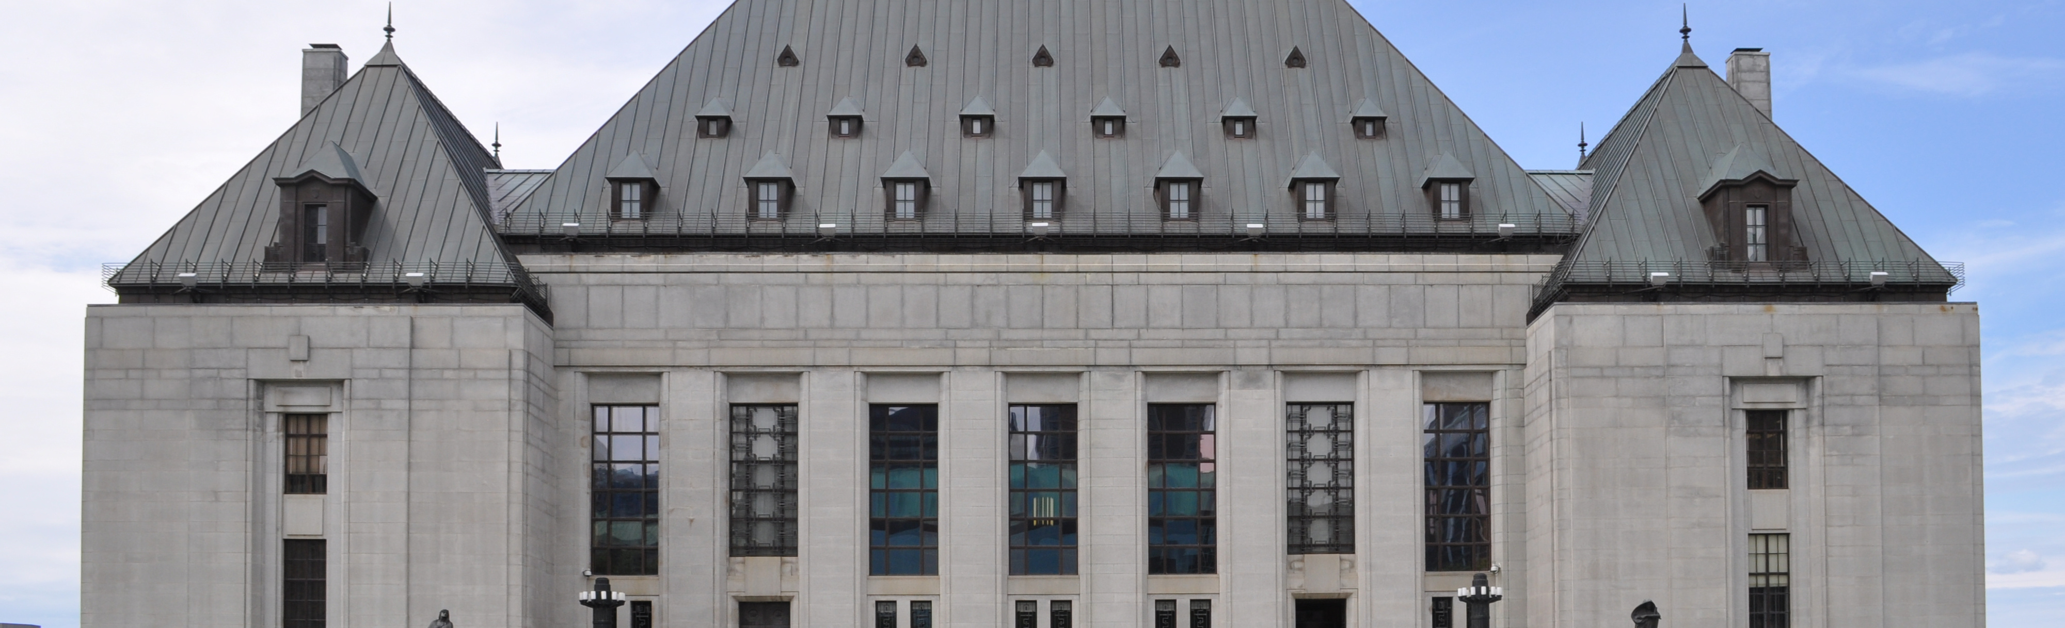
Opposing the enforcement of the Ecuadorian judgment
USA
Decision ultimately for Chevron (2014): the Ecuadorian judgment, fraudulent, shall not be enforced.
Canada
Decision for Chevron (2019): Chevron Canada should not pay for the debts of its parent company, Chevron USA.

Slide 11
Opposing the enforcement of the Ecuadorian judgment
Argentina
Decision ultimately for Chevron (2013): Chevron Argentina, not a party in Ecuador proceedings, should not pay for Chevron USA
Brazil
Decision for Chevron (2017): the Ecuadorian judgment cannot be enforced against Chevron’s subsidiary in Brazil and is not enforceable since it is corrupted by fraud.
Issues to be discussed
Anti-enforcement injunctions
Sufficient connection to allow enforcement of foreign judgements: existence of subdiaries

Slide 12
Bringing arbitration proceedings to « neutralize » the Ecuadorian judgment
Permanent Court of Arbitration, The Hague (Part II): Arbitration against Ecuador based on USA-Ecuador BIT
Interim awards : interim measures to stay the Ecuadorian judgment enforcement (see 2nd Interim award, 16 Fév. 2012) and jurisdiction of the arbitral tribunal (accepted, see 3rd Interim award, 27 Feb. 2012)
Final (partial) award, 30 Aug. 2018 (see award):
the Ecuadorian judgment against Chevron was procured through egregious fraud and corruption by the plaintiffs’ legal team
Ecuador is said responsible for violating of the BIT, for denial of justice, and ordered to pay damages which will be calculated in a further award
The Ecuadorian judgment is unenforceable under international law. Ecuador is ordered “to take immediate steps, of its own choosing, to remove the status of enforceability”.

Slide 13
Ecuador’s Last Resort: Challenging Arbitration

Slide 14
Staying Arbitration Proceedings
USA
Request to stay arbitration: Denied (US Court of appeal, 2nd Circuit, 17 March 2011)
Netherlands
Request to set aside the interim awards on jurisdiction of the arbitral tribunal : Dismissed (District Court of The Hague, 20 Jan. 2016)
Appeal of the district court decision: Decision upheld (Appeal Court of the Hague, 18 July 2017)
Dutch Supreme Court: Motion denied (12 Apr. 2019)

Slide 15
Setting aside the final award
Jurisdiction of Dutch courts
Seat of the arbitration
District Court of The Hague, 16 Sept. 2020
Request rejected (decision in Dutch)

