Slide 1
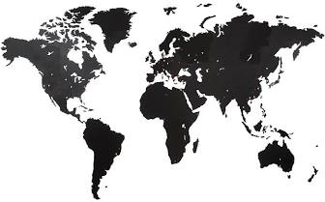
Global Environmental Litigation
Pr. Sandrine Clavel
Dr. Aude-Solveig Epstein
Pr. Patrick Jacob

Slide 2
Survival International v. WWF A case-study
(2020)

Slide 3
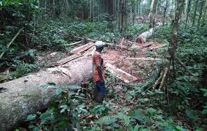
A (very) brief summary of the facts
The Baka People of Cameroon
Early 2000s: Cameroon creates protected areas on Bakas’ territories
The Baka People, legally deprived of access to the forest, is subjected to abuses by police authorities as well as ecoguards.
Survival International, a HR NGO, claims WWF to be partly responsible as supervisor of ecoguards
SI fills a request against WWF before the Swiss OECD NCP

Slide 4
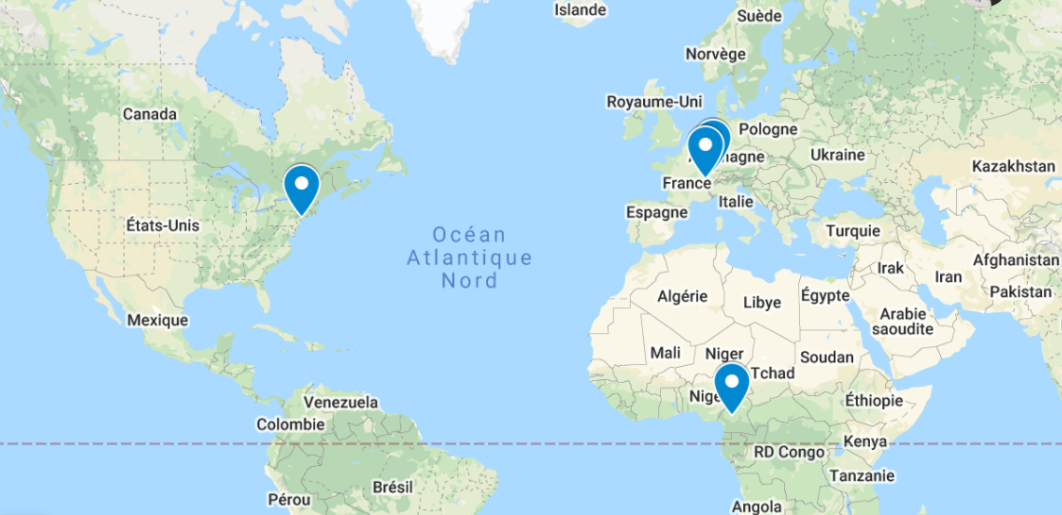
Mapping the dispute
Place of alleged wrongful behavior: Cameroon
And later, Congo
WWF International’ s headquarters: Switzerland
OECD NCP of reference: Switzerland
UNDP: New-York, USA

Slide 5
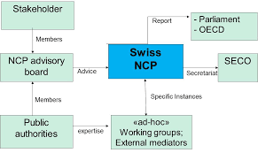
Request filled by Survival before the Swiss OECD NCP

Slide 6
Legal basis
OECD Guidelines for Multinational Enterprises
OECD National Contact Points
The functioning of OECD NCP
Why is it relevant to resort to the OECD NCP instead of “regular” litigation?
Issues
to be discussed

Slide 7
Initial Statement of the NCP – 20 Dec. 2016
Competence
Wrongful acts commmitted in Cameroon
WWF International headquarters in Switzerland
To be discussed: how is the competence of the Swiss NCP founded?
Applicability of the Guidelines
Is WWF international an “enterprise” in the meaning of the OECD Guidelines?
To be discussed: the definition of enterprise, the status of WWF

Slide 8
Proceedings conducted under the supervision of the Swiss NCP
Mediation: Appointment of an external mediator
June-Sept. 2017: Drafting of a confidential joint agreement
4 Sept. 2017: Withdrawal of Survival from the negociation, based on WWF’s objection on prior consent of the Baka people
5 Sept. 2017: Survival’s Public Statement
7 Sept. 2017: NCP’s Statement acknowledging Survival’s withdrawal and violation of confidentiality rules.

Slide 9
Final Statement of the NCP – 21 Nov. 2017
Shared points
Remaining conflicting issues
Recommendations
Issues to be discussed
Effectiveness of the statement?
Alternative remedies? The follow-up of the case…

Slide 10
Follow-up of the case

Slide 11
Further Steps from HR NGOs
Information campaigns
Survival, Minority Rights…
BuzzFeed News
Complaint before the UNDP : 2018
Draft Report 6 July 2020
Impact
Withdrawal of financial support from several States

Slide 12
Further Steps from WWF
Mandate given to an independent panel to investigate
2020 Report: Embedding Human Rights in Nature Conservation
WWF Public Statement
Various HR NGOs’ Statements
L. Dominguez, C. Luoma, Violent Conservation: WWF’s Failure to Prevent, Respond to and Remedy Human Rights Abuses Committed on its Watch, 2020

