Slide 1
An Inter-American perspective: the case of Mayagna (Sumo) Awas Tingni Community v. Nicaragua
Business and Natural Resources Rights

Slide 2
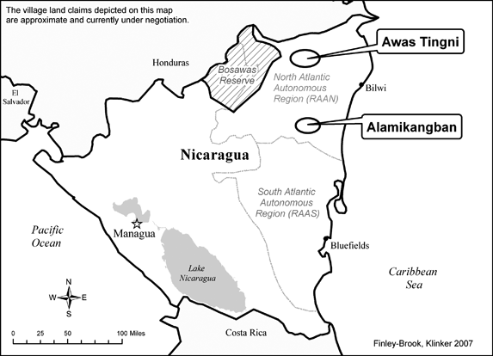
Introduction
The Awas Tingni community is a community of indigenous people living in the Northern Atlantic Autonomous Region (“RAAN”) of the Atlantic coast of Nicaragua. Most community members belong to the Mayagna or Sumo ethnic groups.

Slide 3
March 1992
May 1994
January 1995
The Awas Tingni community signs a contract with Maderas y Derivados de Nicaragua, S.A. (“MADENSA”), for “comprehensive management of the forest.”
The Awas Tingni community, MADENSA, and the Ministry of the Environment and Natural Resources (“MARENA”) all sign a Forest Management Agreement to “facilitate the ‘definition’ of communal lands and to avoid undermining the Community’s territorial claims.”
The National Forestry Service of MARENA approves
a forest management plan submitted by Sol del Caribe, S.A. (“SOLCARSA”), a logging company, to use timber from the lands inhabited by the Awas Tingni community.

Slide 4
April 1995
June 1995
July 1995
The Regional Coordinator of RAAN signs the forest
management plan with SOLCARSA
The Board of Directors of the Regional Council of RAAN approves the agreement signed by RAAN and SOLCARSA and authorizes logging operations in the Cerro Wakambay area.
María Luisa Acosta Castellón submits a letter to the Minister of MARENA on the Community’s behalf, requesting that the process of granting a concession to SOLCARSA be halted until an
agreement with the Community can be reached.

Slide 5
September 1995
The Awas Tingni community files an application for amparo against MARENA officials before the Appellate Court of Matagalpa. The Community asks the court to prevent the officials from granting the concession to SOLCARSA, suspend the concession process between MARENA and SOLCARSA, and require a dialogue process with the Community regarding the use of timber on Community lands.
The Appellate Court declares the Community’s application inadmissible because of Community’s failure to submit the application within thirty days of becoming aware of MARENA’s actions amounts to tacit consent to the granting of the concession.
The Community files an application before the Constitutional Panel of the Supreme Court of Justice for review of the Civil Panel’s decision. The Community argues that it is becoming aware of new violations on a daily basis, thus causing the thirty-day filing requirement to continually reset.

Slide 6
October 1995
…May 1998
Jamie Castillo Felipe, Syndic of the Awas Tingni community, files a petition before the Commission in his own name and on behalf of the Community. He requests precautionary measures to prevent the State from granting SOLCARSA a concession to start
logging on indigenous lands.
The Commission decided to bring the case before the Court.

Slide 7
Article 21 of the American Convention on Human Rights – Right to Private Property
1. Everyone has the right to the use and enjoyment of his property. The law may subordinate such use and enjoyment to the interest of society.
2. No one shall be deprived of his property except upon payment of just compensation, for reasons of public utility or social interest, and in the cases and according to the forms established by law.
3. Usury and any other form of exploitation of man by man shall be prohibited by law.

Slide 8
Court specifically on violation of Article 21 of the Convention
148. Through an evolutionary interpretation of international instruments for the protection of human rights, taking into account applicable norms of interpretation and pursuant to article 29(b) of the Convention -which precludes a restrictive interpretation of rights-, it is the opinion of this Court that article 21 of the Convention protects the right to property in a sense which includes, among others, the rights of members of the indigenous communities within the framework of communal property, which is also recognized by the Constitution of Nicaragua.

Slide 9
149. Given the characteristics of the instant case, some specifications are required on the concept of property in indigenous communities. Among indigenous peoples there is a communitarian tradition regarding a communal form of collective property of the land, in the sense that ownership of the land is not centered on an individual but rather on the group and its community. Indigenous groups, by the fact of their very existence, have the right to live freely in their own territory; the close ties of indigenous people with the land must be recognized and understood as the fundamental basis of their cultures, their spiritual life, their integrity, and their economic survival. For indigenous communities, relations to the land are not merely a matter of possession and production but a material and spiritual element which they must fully enjoy, even to preserve their cultural legacy and transmit it to future generations.

Slide 10
151. Indigenous peoples’ customary law must be especially taken into account for the purpose of this analysis. As a result of customary practices, possession of the land should suffice for indigenous communities lacking real title to property of the land to obtain official recognition of that property, and for consequent registration.
152. As has been pointed out, Nicaragua recognizes communal property of indigenous peoples, but has not regulated the specific procedure to materialize that recognition, and therefore no such title deeds have been granted since 1990. Furthermore, in the instant case the State has not objected to the claim of the Awas Tingni Community to be declared owner, even though the extent of the area claimed is disputed.
153. It is the opinion of the Court that, pursuant to article 5 of the Constitution of Nicaragua, the members of the Awas Tingni Community have a communal property right to the lands they currently inhabit, without detriment to the rights of other indigenous communities.

Slide 11
Outcome on Article 21
Based on the above, and taking into account the criterion of the Court with respect to applying article 29(b) of the Convention (supra para. 148), the Court believes that, in light of article 21 of the Convention, the State has violated the right of the members of the Mayagna Awas Tingni Community to the use and enjoyment of their property, and that it has granted concessions to third parties to utilize the property and resources located in an area which could correspond, fully or in part, to the lands which must be delimited, demarcated, and titled.

Slide 12
Significance
The Inter-American Court of Human Rights was the first human rights body which interpreted the right to property to be understood as to include the right of indigenous people to communal property and not merely the right to private property.

Slide 13
An Inter-American perspective: the case of Mayagna (Sumo) Awas Tingni Community v. Nicaragua
Business and Natural Resources Rights

